Slide 1
OsIf User Mode
ThoNV12

Slide 2
User Mode and Supervisor Mode
Privileged and Unprivileged
User Mode in PPU
SVC
Module

Slide 3
User Mode and Supervisor Mode
+ User mode: This mode is used when an application is running on the chip. In this mode, some registers will not be accessible from application. This mode is used for the purpose of ensuring the safety of source code while the chip is running.
+ Supervisor mode: In this mode the application software has full access to all registers inside the chip.

Slide 4
Privileged and Unprivileged
Processor run at 2 access level:
1. Privileged access level
+ The software can use all the instruction and has access to all resources.
2. Unprivileged access level
+ Has limited access to the MSR and MRS instructions
+ Cannot access the system timer, NVIC, or system control block
+ Might have restricted access to memory or peripherals

Slide 5
Privileged and Unprivileged
How to switch between Privileged and Unprivileged ?

Slide 6
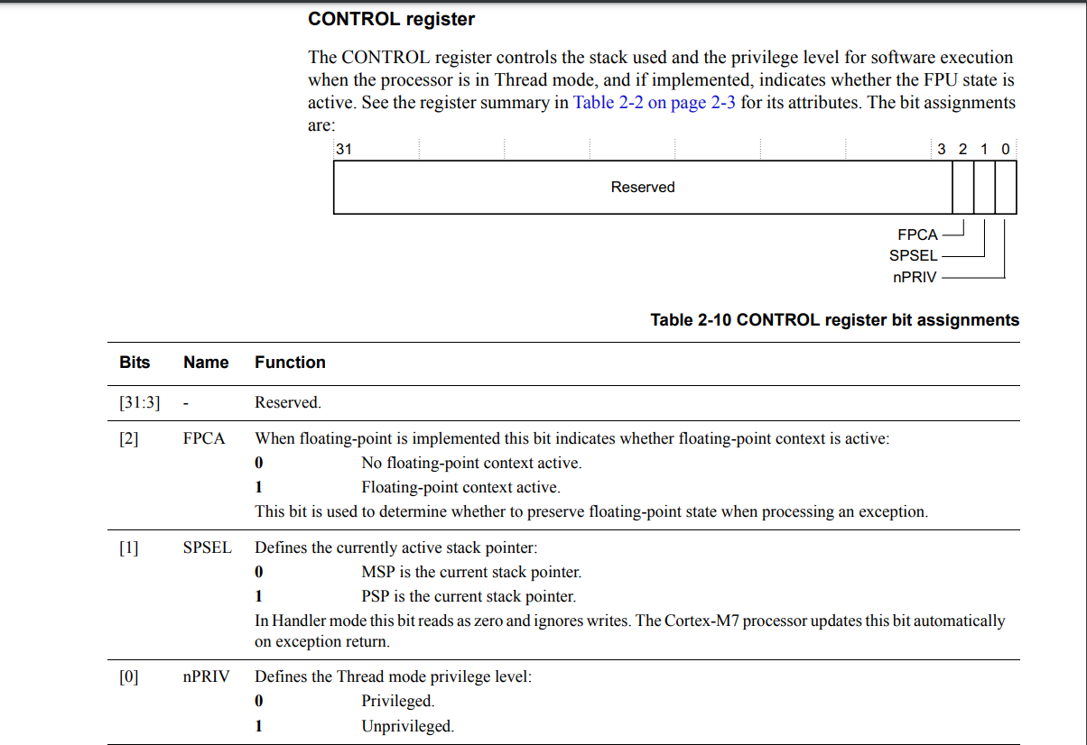
Privileged and Unprivileged

Slide 7
PM
Privileged and Unprivileged
Privileged
CONTROL
Handler mode
X
Privileged
Unprivileged
Privileged
CONTROL
CONTROL
CONTROL
Thread mode

Slide 8
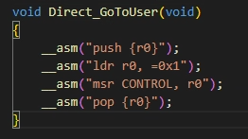
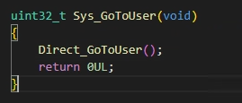
Privileged and Unprivileged
Case 1: Go to User

Slide 9
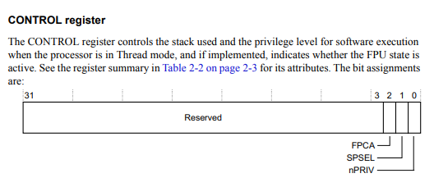
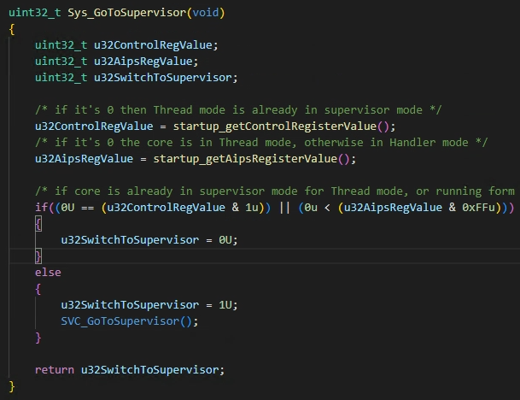
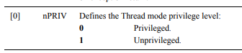
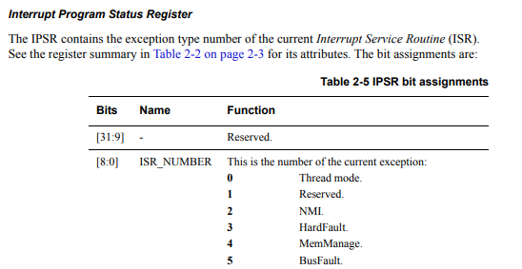
Privileged and Unprivileged
Case 2: Go to Supervisor

Slide 10
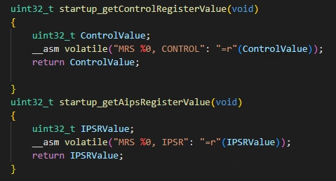
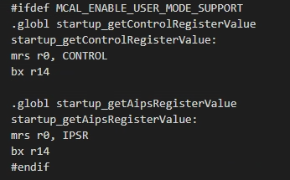
Privileged and Unprivileged
Case 2: Go to Supervisor

Slide 11
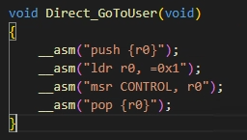
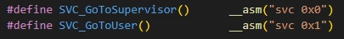
Privileged and Unprivileged
Why ?

Slide 12
SVC ( supervisor Call )
+ Supervisor calls are typically used to request privileged operations or access to system resource
+ SVC is a thumb ISA instruction which causes SVC exception
+ User mode use the SVC instruction to change the processor mode to privilege mode to access privileged resource like peripherals
+ SVC instruction is always used along with a number, which can be used to identify the request type
UM

Slide 13
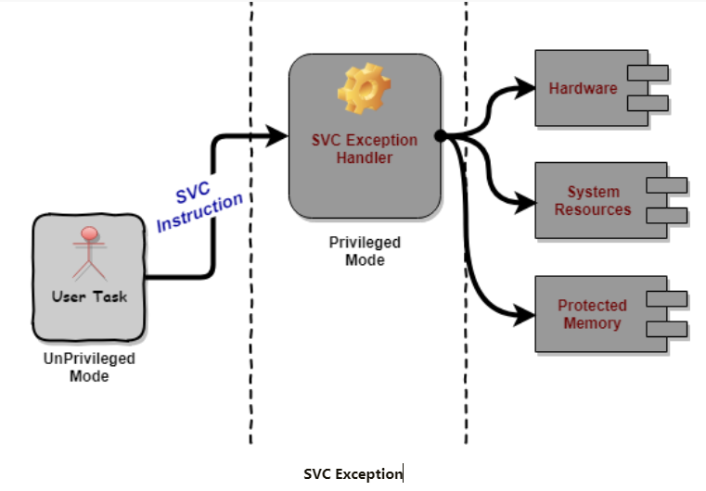
SVC ( supervisor Call )

Slide 14
SVC ( supervisor Call )
User level
Unprivileged
Mode thread
__SVC_request_handler(int svc_number)
{
case 1:
__write();
case 2:
…
}
SVC #0x1
Privileged, handler
Resource
Privileged
X

Slide 15
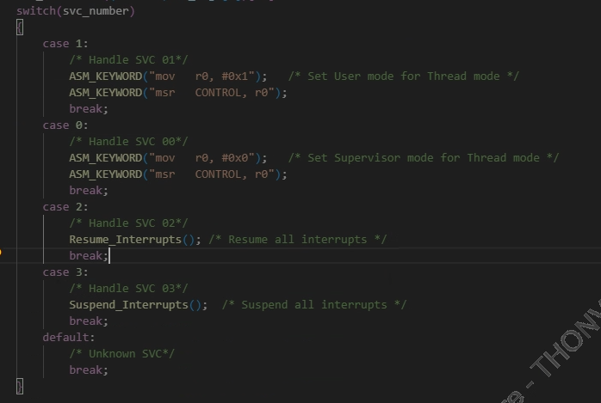
SVC ( supervisor Call )
svc_number ???

Slide 16
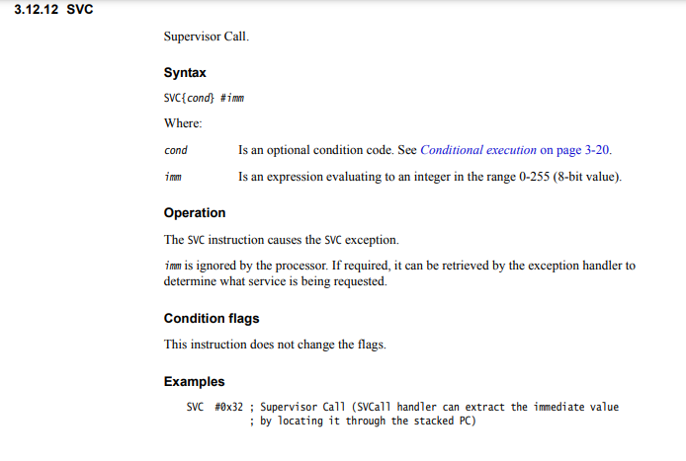
SVC ( supervisor Call )

Slide 17
SVC ( supervisor Call )
https://www.iotality.com/armcm-svc/
Stack frame
Reserved
xPSR
Stacking
MSP
R15 PC Return address
SVC Handler
R14 LR
SVC triggers
R12
+ 6
R3
R2
Thread mode
R1
MSP
R0

Slide 18
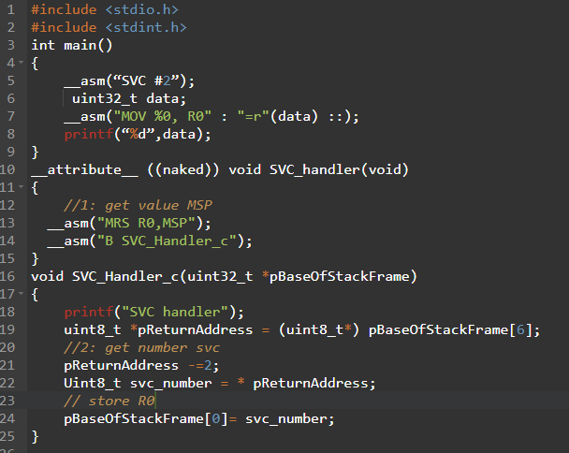
Ham naked khong co mo dau va ket thuc
SVC ( supervisor Call )

Slide 19
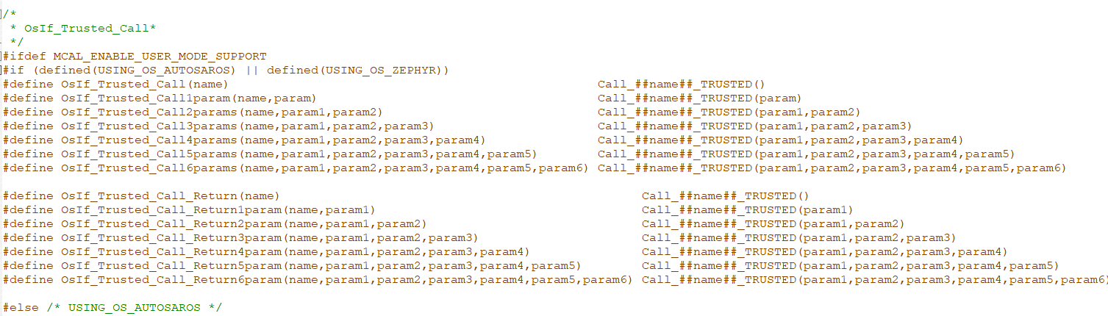
User mode code
When User mode is actived, and user want to access to register of module, they have to call though the macro OsIf_Trusted_Call(name) when init driver and “name” parameter is the name of function that will setup to enable accessing to registers of module. At deinit function, user will call macro OsIf_Trusted_Call(name) again and “name” parameter is the function will setup to disable accessing to registers of module.

Slide 20
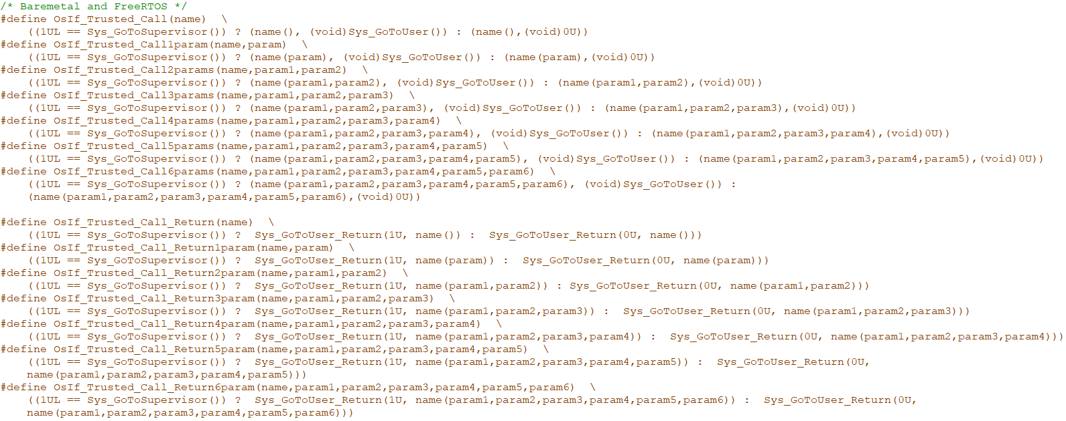
User mode code

Slide 21
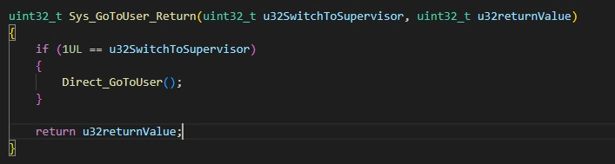
User mode code

Slide 22
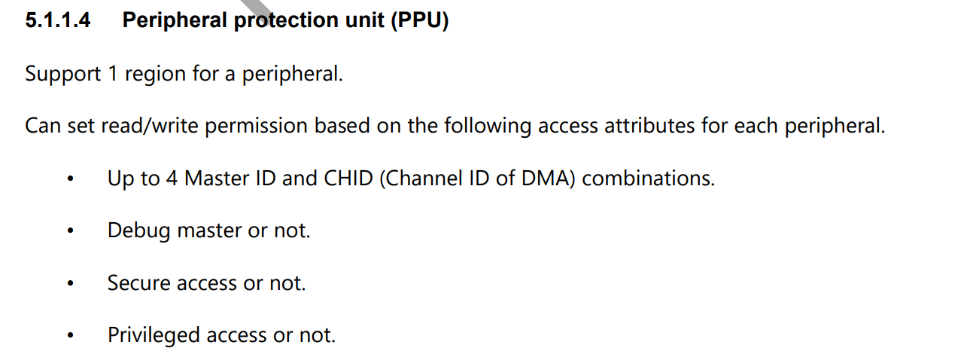
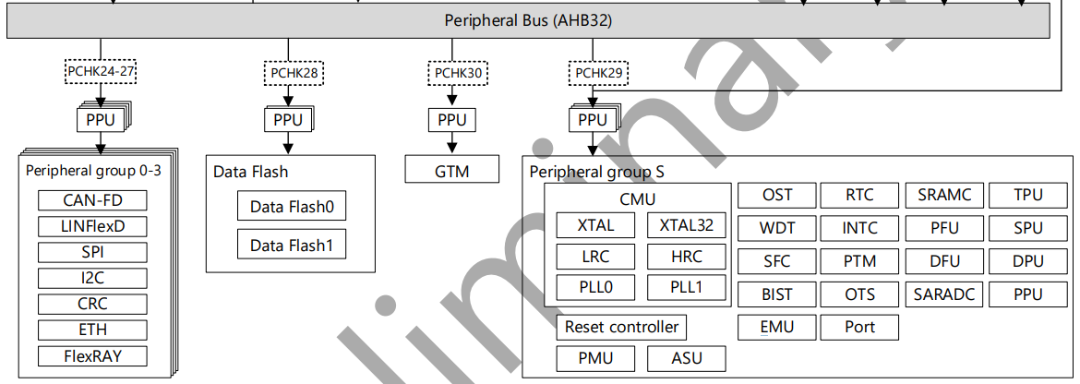
Module

Slide 23
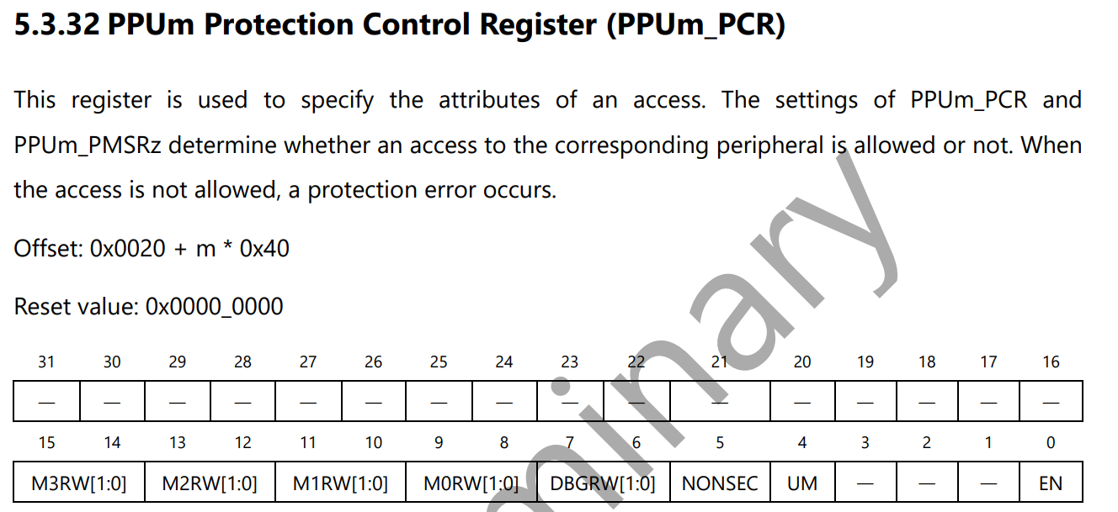
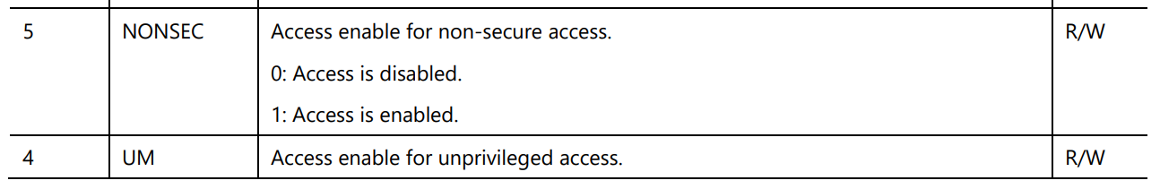
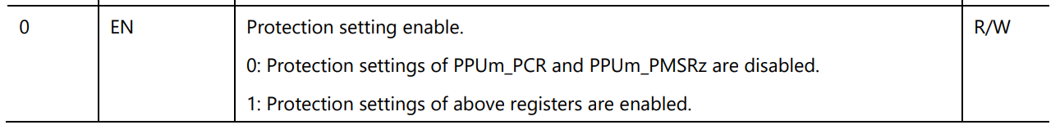
Module Lin
2
1

Slide 24
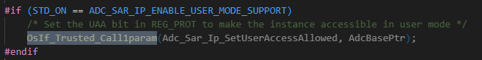
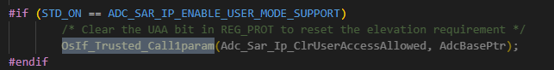
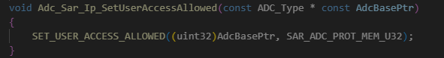
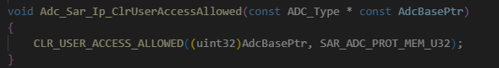
Module
Adc_Sar_Ip_SetUserAccessAllowed() is the function will be called when init module
Adc_Sar_Ip_SetUserAccessAllowed() will config to enable accessing to protected registers of PPU.
Adc_Sar_Ip_ClrUserAccessAllowed() is the function will be called when user want to deinit module
This function will clear UM and NONSEC bits in *PCR register of PPU.

Slide 25
Thanks And Your Slogan Here
Speaker name and title
www.xhsc.com.cn

